Slide 1
LENDING CLUB CASE STUDY
SUBMITTED BY :
1. Sai Viswanadh Kintali
2. Sanskriti Agarwal

Slide 2
PROBLEM STATEMENT
AIM
OBJECTIVE
APPROACH
Based on historic data, identify strong indicators of loan default.
Then using these driving variables at the time of loan application and understanding the risks involved.
Utilise EDA to undertake risk analytics in consumer finance by understanding different consumer attributes as well as loan attributes that influence the tendency of loan default.
To identify the patterns which indicates if a person is likely to default a loan.

Slide 3
ANALYSIS APPROACH
CLEAN DATA
Drop columns with null values, random values or single valued columns.
UNIVARIATE ANALYSIS
Check distributions and frequencies of various numerical and categorical variables. Create derived variables.
BIVARIATE ANALYSIS
Do correlation analysis. Check how two variables affect each other or a third variable. Analyse joint distributions.
SUMMARISE RESULTS
Publish insights and observations.
SEGMENTED UNIVARIATE ANALYSIS
Analyse variables against segments of the final variable.

Slide 4
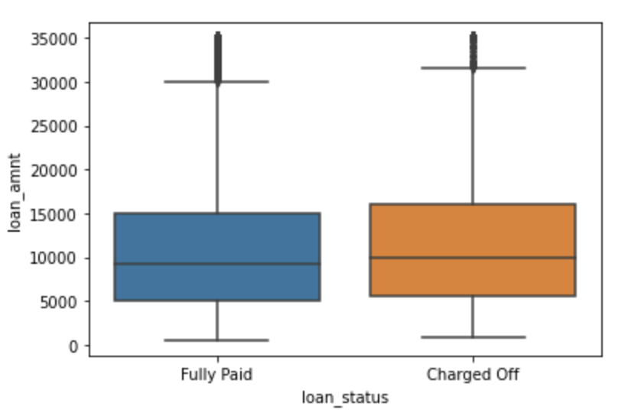
ANALYSIS – LOAN AMOUNT DISTRIBUTION
There is no variation between loan amounts in Fully Paid/ Charged Off loans.
The loan amount varies up to ~35,000 & have a mean of 10,000 in both loan status.

Slide 5
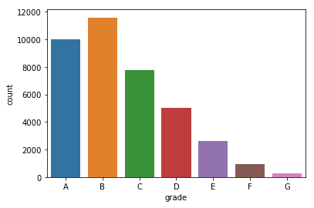
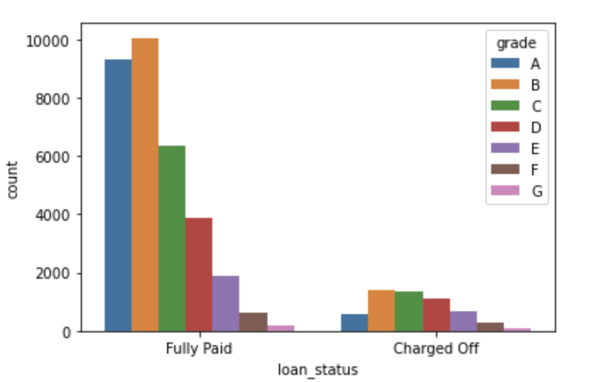
ANALYSIS – GRADES
Most of the loans are high graded (grade of A and B) loans, about > 50%.
Majority of the Charged Off loans are from B, C, D Grades

Slide 6
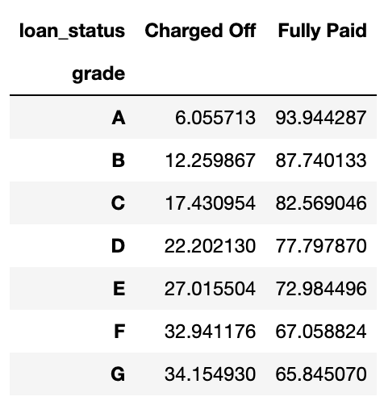
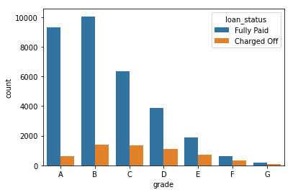
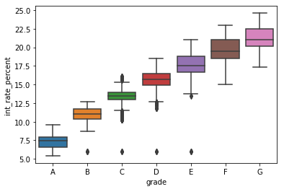
ANALYSIS – GRADES (continued)
Change of rate is increasing with the increase in Grade (from A to G).
Interest Rate is also increasing from Grade A to G, which is in parity with the increase in Charged off rate.

Slide 7
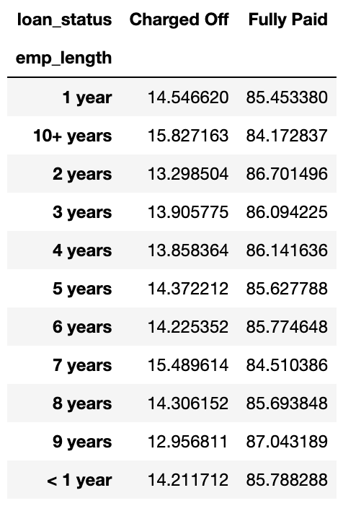
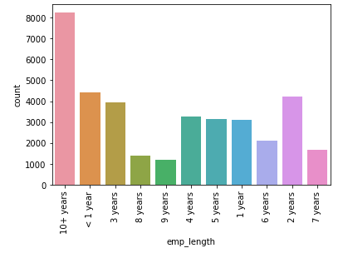
Analysis – Employee Experience
Most of the loans are taken by employees with more than 10 years exp (~25%).
But Charge-off rate across all the categories is same.

Slide 8
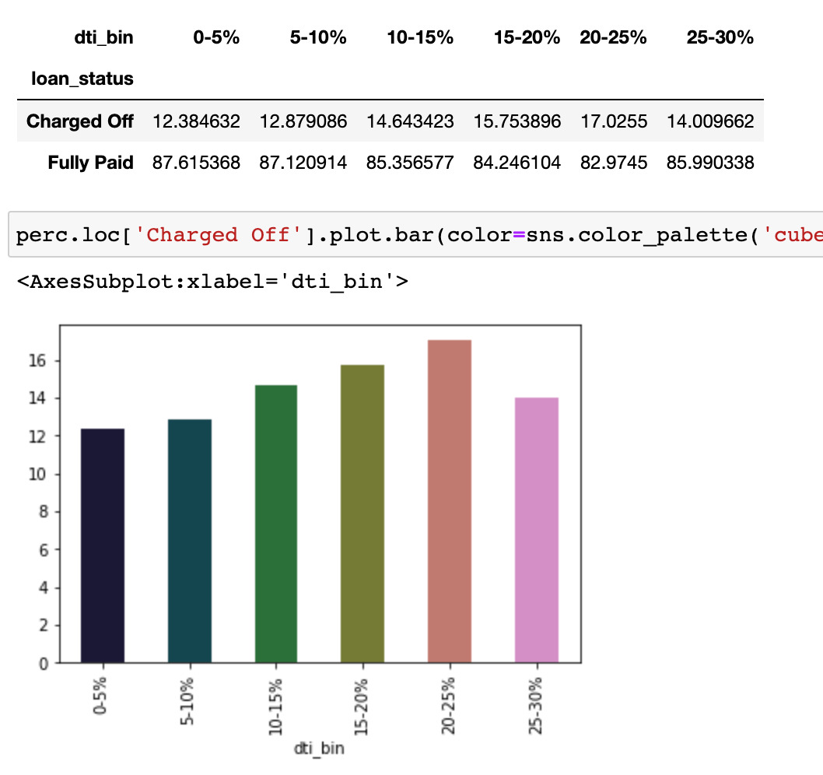
ANALYSIS – DTI (Debt to Income Ratio)
Charge-off Percentage is increasing with the increase in DTI

Slide 9
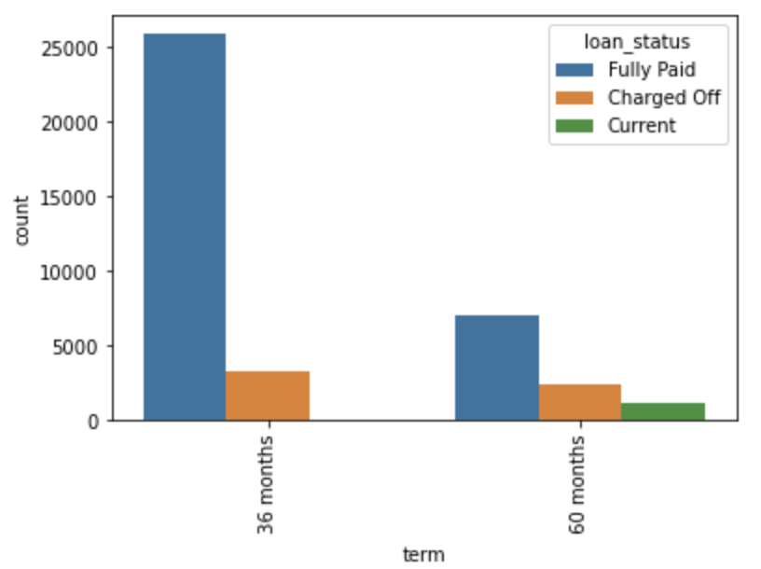
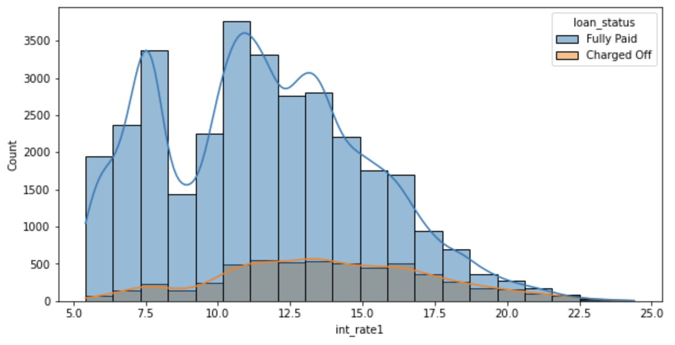
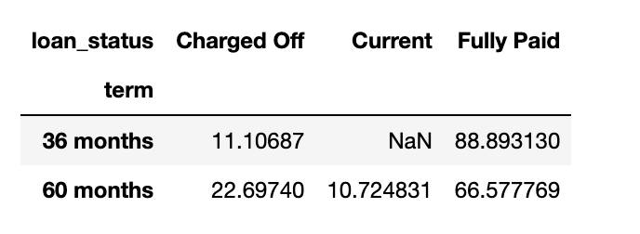
Analysis – Term & Interest
There is a spike in Charged off cases when interest rates between 11%-17%.
Majority of the loans are short-term (36 months) but the charged-off rate is very high in long-term loans (60 months).

Slide 10
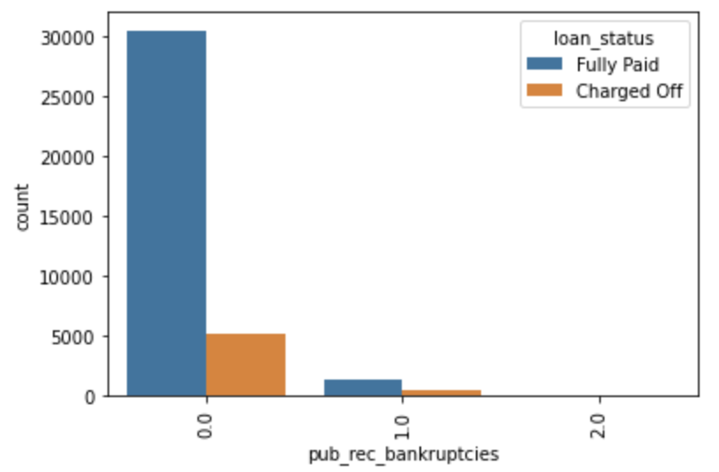
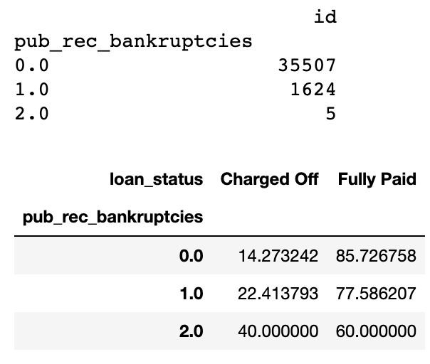
Analysis – Public Bankruptcies
Majority of the clients have 0 Bankruptcies (~96%) but clients with Bankruptcies have a high chance of default/ Charged-off loan.

Slide 11
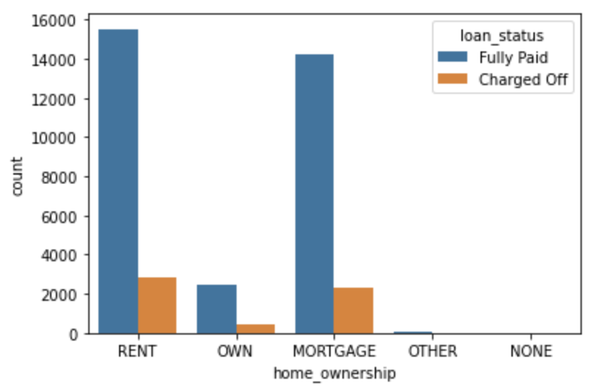
Analysis – Home Ownership
Majority of the clients are lacking own properties and are on Rent, Mortgage. These type of clients have high Charge-off rate.

Slide 12
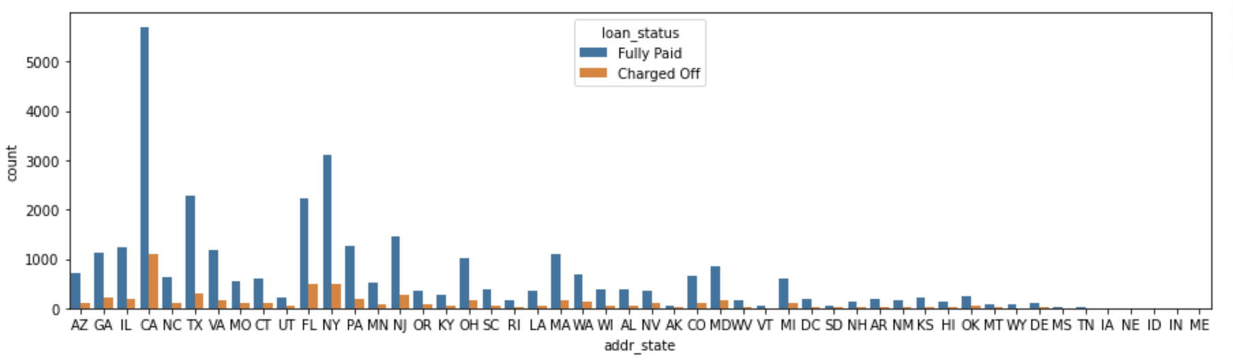
Analysis - Location
Most of the loans are form CA. Charge-Off Rate from CA is also one of highest compared to other states.

Slide 13
RESULTS
Low grade loans have high tendency to default . Most of the loans which are defaulted are from grade B, C ,D.
Loans having higher interest rates have more defaulters. Hence, check the background of applicant thoroughly , if the interest rate is high.
Extra scrutiny must be done for the applicants belonging to CA state, as tendency to default is high.
When the purpose is debt consolidation , check applicant thoroughly as it has high tendency to default.
Lower interest rates coupled with short term and easy EMI decrease the chances of default.

